Slide 1
Managerial Economics and
Organizational Architecture Chapter 14:
Attracting and Retaining Qualified Employees

Slide 2

Contracting Objectives
Firms wish to design employee compensation contracts to maximize the value of employee’s output net of costs; alignment of interests (eller; maksimér differencen mellem total-nytten og -omkostningerne)
Individuals must receive at least their reservation utilities (opportunity cost):
def.; the level of satisfaction they could receive in their next best alternative
Compensation is a key to reach this utility
Payment is for attracting, retaining and motivation!
Kilde: https://x.com/pointaccountant/status/1383721978482204673

Slide 3
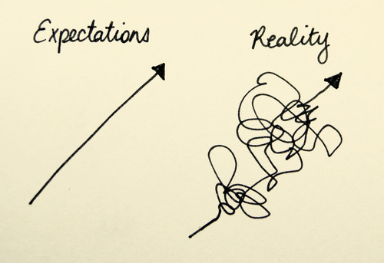
The Basic Competitive Model
Initial assumptions:
competitive labor market
wages determined by supply and demand (only!)
all jobs are identical
all workers are identical
current market wages are costless to determine
no long-term contracts exists meaning that all labor is hired in ‘spot’ markets
all compensation is monetary (to simplify)
Assumption
Kilde: https://writingyourfirstnovelblog.com/2019/11/07/unrealistic-expectations/

Slide 4
The Competitive Model of Employment and Wages; The firms choice
Each firm hires until
Marginal Revenue Product (MRP) = Market Wage (alias MC)
when MRP > the market wage the worker adds more to the value of the output than to costs
When MRP < the market wage the worker costs more than what she/he adds to the value of output
$
Wage (in dollars)
Market Wage Rate (MC)
Marginal Revenue Product (MRP)
E
E*
Number of employees

Slide 5
Relaxing the Assumptions
All jobs are not identical;
employees will choose the most desirable job for a given level of pay
firms must offer compensation for undesirable characteristics
Workers are not perfect substitutes
Information is costly
Jobs may be long term
Compensation takes many forms
(closer to)
Kilde: https://writingyourfirstnovelblog.com/2019/11/07/unrealistic-expectations/
Sammenlign med planche 3.

Slide 6
Human Capital
Individuals differ in their abilities, skills and training
General human capital is applicable to many firms;
workers are willing to pay for general training, the firm is not; the benefit goes to the worker!
Specific human capital is useful to the current employer, but does not have much value outside the job;
the firm is willing to pay for specific training

Slide 7
Compensating Wage Differentials
Firms have to pay extra compensation to attract workers to less desirable jobs – def. 440ø.
Individuals averse to these less desirable job attributes choose a lower paying job without these attributes
Workers and firms are matched by workers desire for job attributes and the firm’s ability to offer these jobs
Bemærk MA-casen;
Slime Line/Bill Razpotnik;
reglen eller undtagelsen?

Slide 8
Internal Labor Markets
Outside hiring is (usually) for entry level jobs
Promotions are (usually) from within
(ind – og derefter opslusning ….. med undtagelser…)
These (promotions) helps establish a long-term employment relationship
Ramme 443m. (vigtigt);
Explicitte kontrakter – formal written agreements
Implicitte kontrakter – shared informal understandings

Slide 9
Long Term Relationships (LTR)
Through incentives LTR results in greater levels of firm-specific human capital investment - spot market exchange is expensive in the long run for firms (jvf. også kap. 19).
LTR leads to greater employee motivation.
LTR accomplish a better matching of employees to jobs over time.

Slide 10
Pay in Internal Labor Markets
Since ‘relationships’ are longer term, career earnings are used in decision making instead of MRP:
Firms can pay below MRP initially and
Above MRP later in the relationship….

Slide 11
Upward Sloping Earnings Profile
$
Compensation
Marginal Revenue Product
Salary (in dollars)
T
Tenure with the firm

Slide 12
Pay in Internal Markets
Reduce corruption in the Chicago Police Force, p. 446 (central case)!
1) Høj straf + lille sandsynlighed for at blive opdaget blev ‘oversat’ til ‘high efficiency wages’
2) Stillingerne blev solgt ‘på auktion’ til de ansøge-re, der havde mest tillid til, at de ville kunne modstå bestikkelse (tillid til sig selv) =>
den høje løn ville blive deres, samt,
bonding-costen/ auktionsprisen for at få stillingen, ville blive tilbagebetalt ved ansættelsesforhol-dets ophør, hvis de ansatte undlod at tage imod bestik-kelse medens de var ansat.
Efficiency wages;
def.; compensating higher than market rates when monitoring and precise measurement is difficult
can motivate workers not to shirk, make good quality and quantity
Compensation typically rises with seniority due to higher productivity
Incentives to work in best interest of the firm, acquire firm-specific human capital
Ramme 445 – 450!

Slide 13

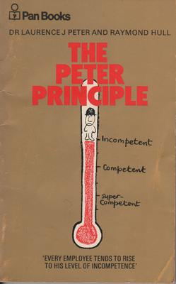
Promotions as Tournaments
Employees compete for promotions within the organizational hierarchy
The employee with the best relative performance is chosen
the filtration of random shocks (uddybes i kap. 16).
Promotion systems have drawbacks;
undermine cooperation
are more ‘discrete’ (yes/no) than monetary rewards (afstedkommende at finjustering ved ‘monetary rewards’ er mulig)
the ‘Peter Principle’ may apply
employees may not value promotions
influence costs may rise
Kilde: https://stock.adobe.com/dk/search?k=tournament&asset_id=494653408
Ramme 448
Kilde: https://en.wikipedia.org/wiki/Peter_principle

Slide 14
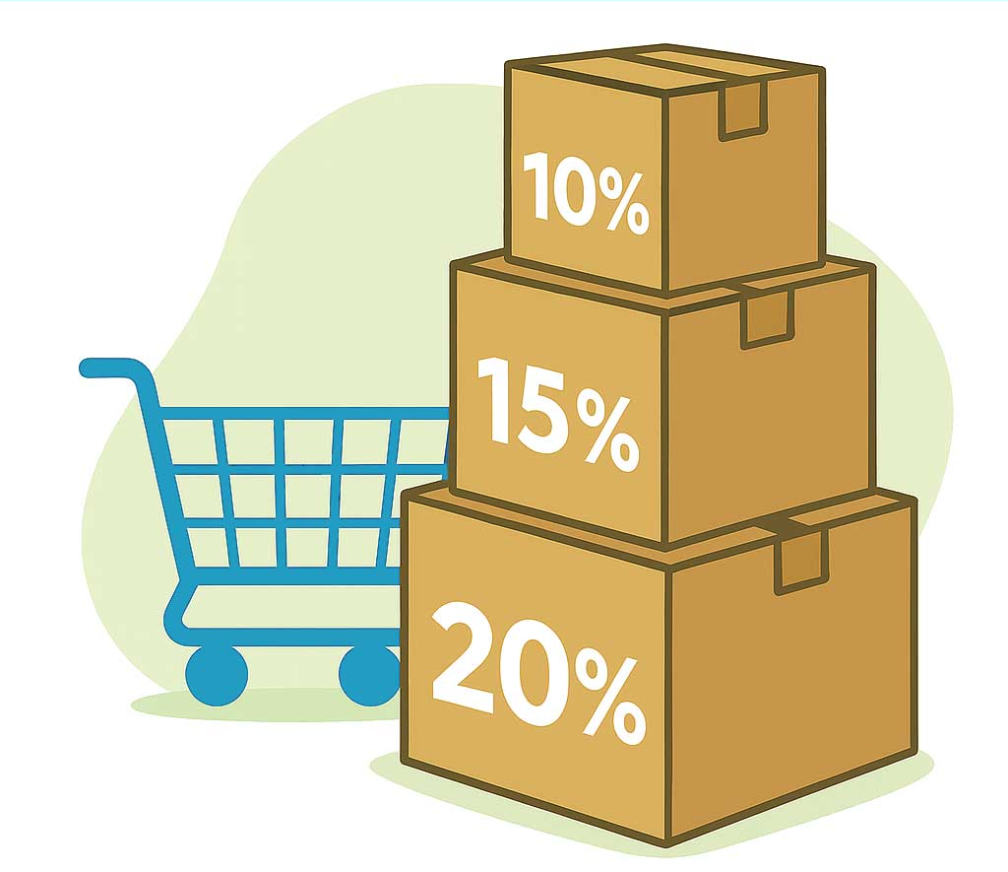
Compensation Components; salary and fringe benefits
Salary and fringe benefit compensation are not perfect substitutes for employees:
the role of taxes
firms may purchase fringes at lower price
Employees may wish to trade between salary and fringes to attain optimum combination
Kilde: https://www.emob-moebel.de/mengenrabatt
Virksomheder kan typisk købe ’fringes’ billigere end medar-bejdere grundet kvantumrabat (forsikringer)

Slide 15
Employee Preferences for Salary and Fringe Benefits
$
Employee Preferences
U₂
Indifferenskurver
Bemærk hældningen!
‘MRTS’?
Salary (in dollars)
U₁
$
Fringe benefits (in dollars)

Slide 16
Employer Preferences for Paying Salary or Fringe Benefits
$
Isocost (salary + fringe) curves
Salary (in dollars)
-1
-1
$
Fringe benefits (in dollars)

Slide 17
The Optimal Mix; Salaries Versus Fringes
Maximize firm value by meeting potential employee’s reservation utility at lowest cost
Individuals must receive at least their reservation utilities (opportunity cost) – the level of satisfaction they could receive in their next best alternative
Indifference curve must be tangent to an isocost curve! We know….
If not, the individual's reservation utility is not met!

Slide 18
Optimal Mix Between Salary and Fringe Benefits
$
Salary
S*
U
$
F*
Fringe benefits (in dollars)

Slide 19
Salary-Fringe Benefit Choice
Management should focus on the preferences of the employees and offer the benefits they want. Why?
Employees are willing to trade off salary for benefits.
In the real world we must account for taxes on both the firm and employee side…

Slide 20
Optimal Choice of Salary and Fringe Benefits with Payroll Taxes
$
Tax on wage, not on fringe => ?
Salary (in dollars)
S*
S’
U
Payroll taxes
No payroll taxes
F*
F’
$
Fringe benefits (in dollars)

Slide 21
Attracting Particular Types of Employees with the Salary-Benefits Mix
$
Bemærk;
’the cafeteria-style-benefit – package’, 456n.
$_{S}
Reservation utility: Single person
Salary (in dollars)
$_{M}
Reservation utility: Married person
Jf./overfør til danske forhold; + sygesikring?
$
F_{S}
F_{M}
Fringe benefits (in dollars)

